Slide 1
SQL vs NOSQL

Slide 2
SQL Overview
Relational database
Uses pre-defined schemas
Requires a lot of upfront modelling work
All data must follow the same structure
Changes to data structure can be very disruptive to system
Benefits the most from vertical scaling
Better equipped for multi-row transactions
ACID properties

Slide 3
ACID Properties
Atomic | All parts of a transaction occur or none occur
Consistent | Database will never be left in a half way state between transaction
Isolated | Transactions occur in isolation and the results of one transaction are not available to another before it completes
Durable | Once the change is made to the database it is permanent. On system failure the committed data should be safeguarded

Slide 4
Table-Based
Based on traditional relational models data is stored in tables
Each row is a unique record
Differentiated based on Key
High degree of data consistency
Use case: Bank transactions, accounting systems, stock management
Example: SQL Server, MySQL, etc.

Slide 5
NOSQL Overview
Not Only SQL
Non-relational database
Data structure is dynamic
Can use different kinds of storage – Document, Graph, etc.
No need to pre-define structure
Each document can have unique structure
Benefits most from horizontal scaling
CAP theorem

Slide 6
CAP Theorem
Only 2 of 3 of the following can be guaranteed in a distributed system at a time:
Consistency | Every node in the system will have the most recent copy of the data available for incoming transactions, i.e. all users will have the same view.
Availability | Each read or write request will either be processed successfully or will receive a message that the operation cannot be completed.
Partition Tolerance | If 1+ nodes go down the system will still uphold its consistency guarantee. When the failing nodes become available again they will recover gracefully.

Slide 7
Key-Value Pairs
Stores data in Key-Value pairs
Only allows query by key
Database doesn’t know anything about value contents
Doesn’t allow secondary indexes
Example: Redis, DynamoDB
Use case: session storage, shopping cart

Slide 8
Document Based
What is a document?
A record in a database that stores info about an object and any related metadata
Documents store data in key-value pairs
Variety of structures such as JSON, BSON, XML
Advantages:
Data accessed together is stored together
Maps to directly to objects in OOP
Example: MongoDB, CosmosDB

Slide 9
Graph
Used to model relationships between data
Models data as Vertices (points) and Edges(relationships)
Used to :
Find hidden connections between distant items
Navigate deep hierarchies
Discover inter-relationships between items
Use case: fraud detection in banking systems, social media analysis
Examples: Cassandra, Neo4j

Slide 10
When to use SQL
Data is high structured and infrequently changes
Support for transaction oriented systems, e.g. accounting systems
Require a high degree of data security and integrity
Routinely perform complex queries or ad-hoc requests
No need for the scale-out capabilities of NOSQL

Slide 11
When to use NOSQL
Working with large amounts of unstructured/semi-structured data
Dynamic schema
Horizontal scaling across geographic locations
Avoid overhead of more structured data approach
Don’t require the level of data integrity SQL offers

Slide 12
Considerations for SQL Databases
Normalising table structures
Breaking table structures down into smaller tables to prevent duplication
Keys for tables – natural key vs surrogate key
Natural – data used that can inherently act as a unique identifier
Surrogate – artificial data such as an int or guid that has no meaning by itself
Relating referential tables
Using foreign key relationships
Structuring Many-to-Many relationships
Creating table structures to store complex relationships
Creating appropriate indexes

Slide 13
Considerations for NOSQL Databases
Partition key
Decides which partition the record gets stored in
Ideal key will give an even spread of documents across partitions
Which data should be stored in the same document vs split into separate documents
Rule of thumb: data that is accessed together should be stored together
Consistency level
Ranges from Eventual to Strong
Knowing which indexes aren’t required
Notes:
Consistency levels:
Strong – Guarantees access to most up to date data
Bounded staleness – allows defining a certain level of time or writes to be behind on
Session – Default level, guarantees you see your own latest writes
Consistent prefix – guarantees there will be no out of order writes but no staleness guarantee
Eventual – no guarantees in order of reads, highest availability

Slide 14
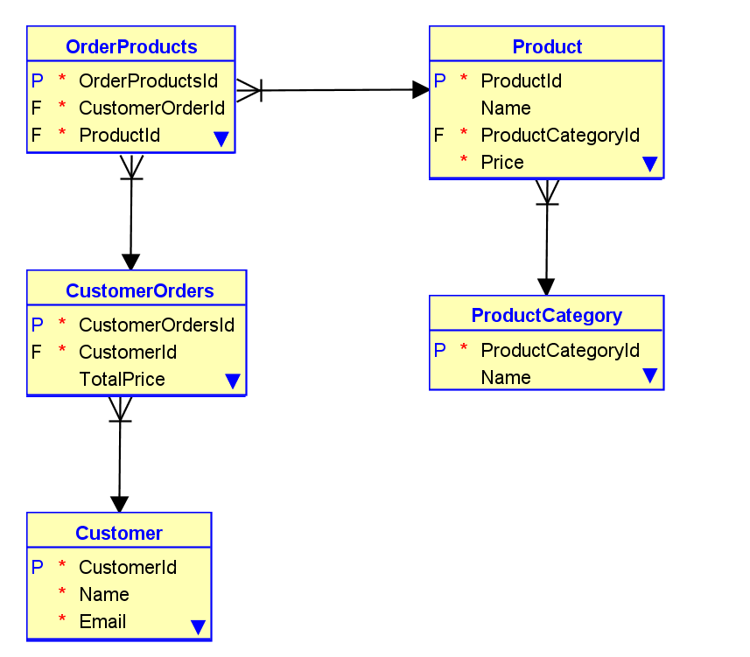
SQL Table Structure

Slide 15
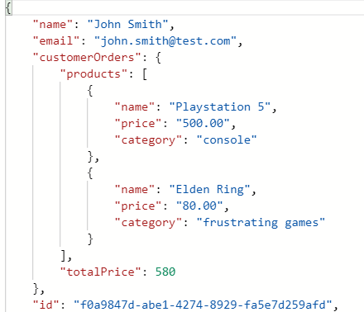
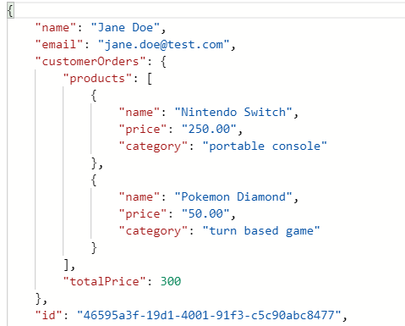
NOSQL Document Structure

Slide 16
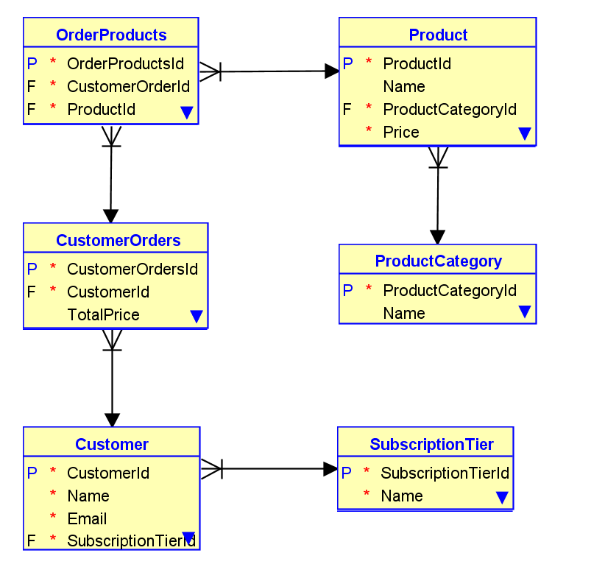
SQL Table Structure 2

Slide 17
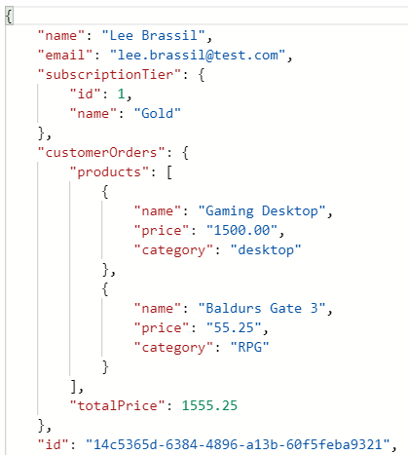
NOSQL Document Structure 2

Slide 18
Summary
 | SQL | NOSQL
Language | Widely known and used | Less well know and used
Scalability | Vertical | Horizontal
Structure | Table-based | Key-value pairs, document-based, graph, etc.
Schema Design | Fixed | Dynamic
Support | Widely available | Less-widely available
Usage | Suited for complex queries | Less suited for complex queries
Property followed | ACID | CAP
Examples | MS SQL Server, MySQL | MongoDB, GraphQL, CosmosDB

Slide 19
Cosmos DB Walkthrough

Slide 20
References
https://www.geeksforgeeks.org/difference-between-sql-and-nosql/
https://www.red-gate.com/simple-talk/databases/nosql/how-to-choose-between-sql-and-nosql-databases/
https://www.oracle.com/ie/autonomous-database/what-is-graph-database/#:~:text=of%20graph%20databases-,Graph%20Database%20Defined,are%20not%20equipped%20to%20do.
https://neo4j.com/developer/graph-database/
https://docs.microsoft.com/en-us/azure/cosmos-db/consistency-levels

